Slide 1
Super shoppers
Capstone Data Analysis QMB4900
By: Shaun Pritchard
February 1, 2021

Slide 2
Super Shoppers
Initial data analysis to discover points of failure and loss within the company.

Slide 3
DATA aNALYSIS oVERVIEW
Key Points:
Analysis to present informed business intelligence using Supper Shoppers store and warehouse data set. This is an analysis used to answer several business questions and identify points of failure in the line current Super shoppers schema across each 3 departments affiliated with their chain of 10 stores.
Analysis - Overview of data and highlights
Findings - findings discovered by the data
Summary of Issues - issues and cause of failure by department and category prioritized by store location and amount of loss
Proposed Solutions - proposed solutions and explanations
Analysis reports and recommendation for data allocation and metrics to track
Notes:
Here is the initial analysis and subject intro to guide the presentation:
Supper shoppers has 3 main departments we will be using two analyze and Report analytical visualizations based on the need and operations of each department.

Slide 4
analysis
Initial data analysis of Super Shoppers grocery chain.
—DATA DRIVEN RESULTS
Notes:
Welcome to the 1st presentation section the analysis

Slide 5
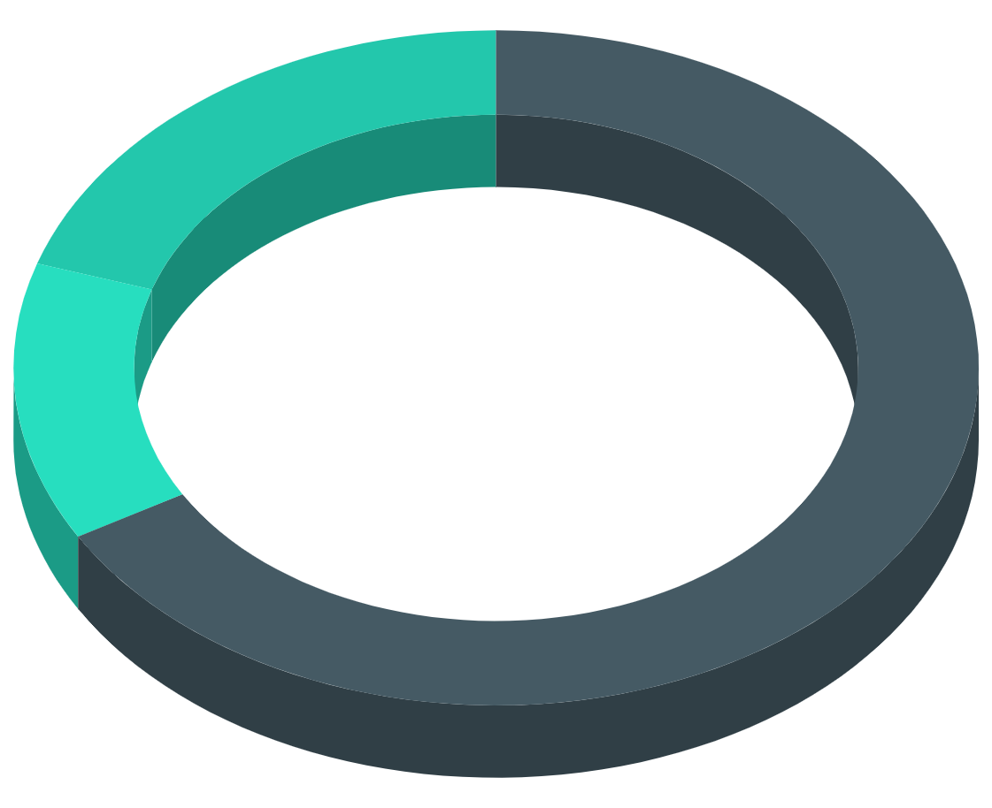
Analysis section one
Total Products
3-department categories
Store
Warehouse
Accounting
26
4- Inventory Items
Kitchen Product
Bathroom products
OTC medicine products
Office products
Notes:
Add business questions here

Slide 6
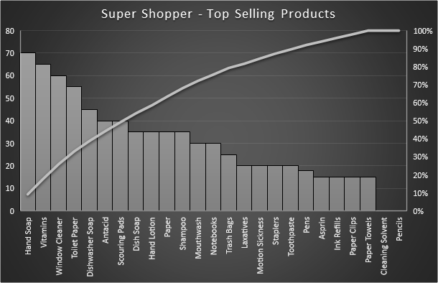
Top Selling Products
Top 3 Selling Items
Hand soap,
Vitamins
Window cleaner
Notes:
Across All Stores

Slide 7
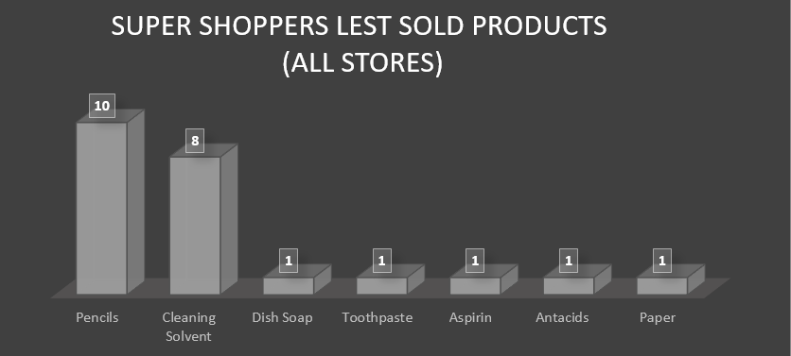
Less Selling Products
Worst Performing products
Pencils
Cleaning solvent
Notes:
These are the worst performing items across all stores!
Pencils have had 0 sales in 8-weeks
Cleaning solvents have only sold 5%

Slide 8

Product metrics
Margin
Gain & Loss
Kitchen
20%
83.3%
LOss
bathroom
20%
17%
Profit
Otc medicine
20%
07%
Avg
office
20%
Based on calculation derived from totals of all stores combined
Notes:
Shows margins and gians and loss

Slide 9
Combined analysis
16.7% Gross Margin
20%
Sales Margin
$30,066.00
ROI sales margin per week
NUmber of Sales
Total sales 8 weeks
$5,011.00
Profit
467
Profit in sales minus COGS
OOS (Out of stock)
Combined weeks OOS at all stores
Notes:
This is the combined metric analysis of all 10 store locations.

Slide 10
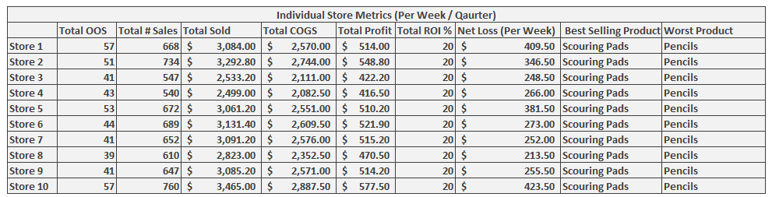
Data For All 10-Store locations
Notes:
This chart individual store breakdown what did she landed salesperson store the total product sold cost of goods, it's profit, ROI, and best selling and worst selling products including the net loss per week. But not lost his face. The out of stock the lost from not having the product on hand and in inventory at the stores location.

Slide 11
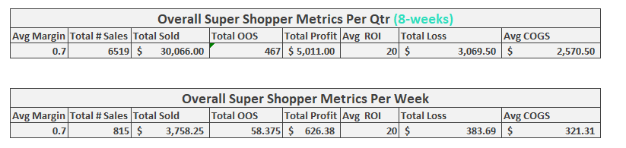
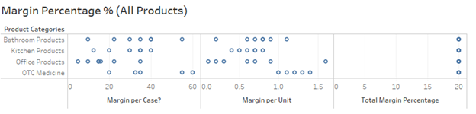
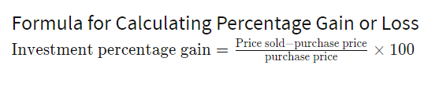
Totals analysis
Notes:
The average margin is the average amount of margin profit for all the products combined(mean variance) the show is over in 8 weeks time and a weekly. The number of sales of individual items. The shows the combined total of out of stock items when a week was Marked zero for NO product and there was no inventory for that item. I then calculate the total loss based off of the average margin and the number of out of stock items summing those up some subtracting the COGS (cost of goods sold). Here we could see the gain or loss.

Slide 12
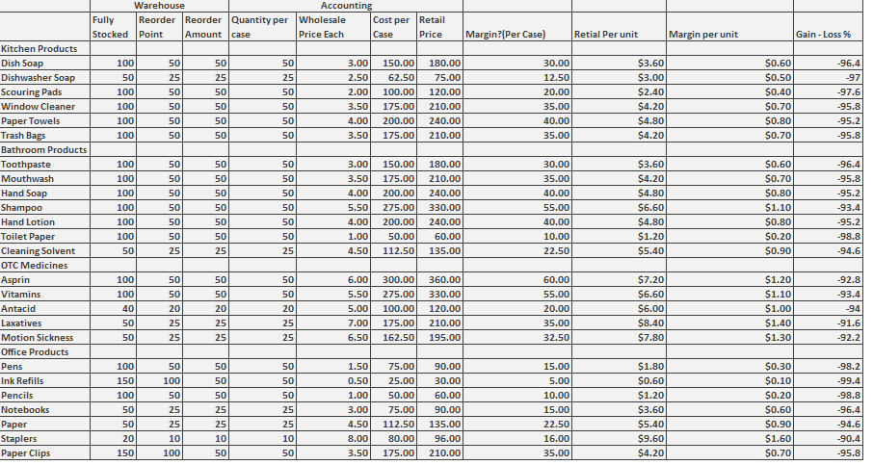
Warehouse analysis
Notes:
These are the worst performing items across all stores!
Pencils have had 0 sales in 8-weeks
Cleaning solvents have only sold 5%

Slide 13
findings
Findings based on the initial Supershoppers data analysis.

Slide 14
Business intellegence
warehouse
POS (point of sale)
Store locations
Accounting
Notes:
Add business questions here

Slide 15
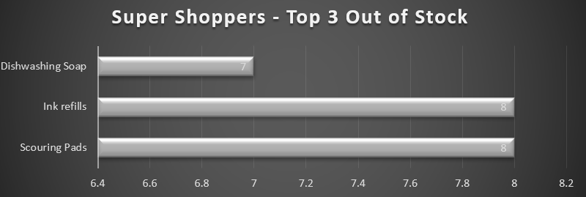
(OOS) - Out Of Stock Products
Products out of stock
Dishwashing Soap
Ink refills
Scouring Pads
Notes:
The data finding showed that the out of stock frequency for best selling products were as followed.
This means across all stores these products were out of stock the most when needed by consumers. Which means loss of revenue and profit for not having these items on hand

Slide 16
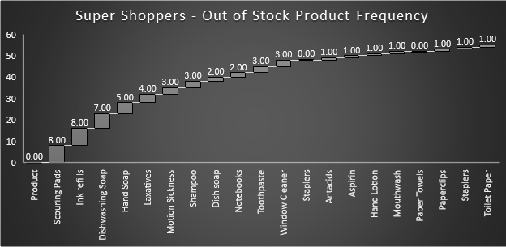
Out of stock frequency - all products
Notes:
For the more we can look at all of 26 products to see the out of stock product frequency. It shows us all items which have been out of stock within a 8 week quarter period.

Slide 17
Findings - 1
1.Stores with stock out issues
2.Reorders not filling demand
3.loss of net gains
Notes:
Found stores where going weeks without products properly in stock
Found reorders not arriving on time order not filled to meet demand

Slide 18
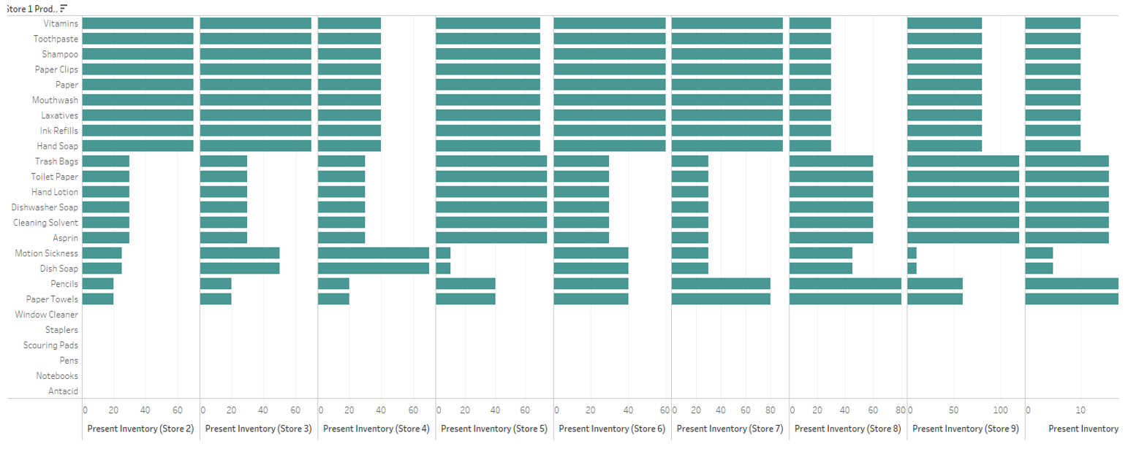
Individual store inventory
Notes:
Findings show that stores where going weeks without in demand products while holding products that never sell.

Slide 19
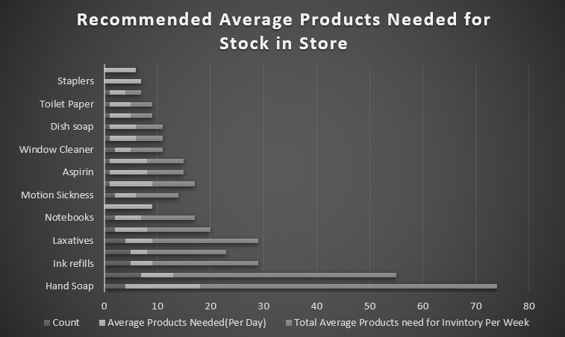
Average recommended products on-hand
Notes:
This chart shows the average based on calculations of products needed in each store per day to sufficiently keep up with customer demand on average.

Slide 20
Store performance
BEST
worst
Store 8
39 OOS
57 OOS
Store 1
Store 3
41 OOS
57 OOS
Store 10
Store 7
41 OOS
51 OOS
Store 2
Store 9
41 OOS
Based on calculation derived from totals of all stores combined OOS.
Notes:
Based on OOS items and frequency of refills on orders. THE Best stores had best performance and less stockouts while other stores had worst performance sue to stockouts.

Slide 21
Warehouse findings
Takes 2-4 weeks to fill orders
Fixed amount of refill items (5-10)
Top selling products reorder points to high
low -selling products reorder point to low
Bad Stock & Inventory Management systems
Notes:
found that on average it takes the warehouse 2-4 weeks to supply a store with the products they need and are selling out of.
also when the warehouse sends products they are only filling orders of up to 5 products.
this means the loss of potential sales for top selling products is -show chart
this leads to the determination that for top selling products have a reorder point th stock and inventory management system that is costing super shoppers money is:
to high
inivorty amounts that are to low
and ineffective

Slide 22
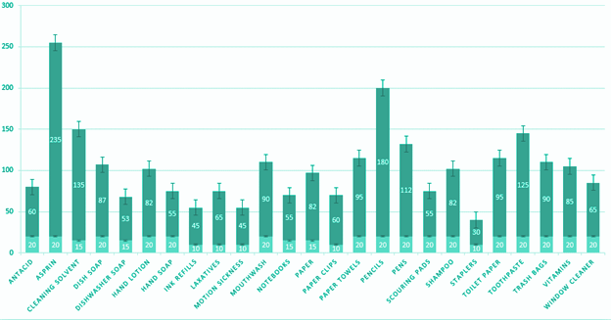
Sell through rate conclusion
Notes:
STR -Conclusion: the data supports the hypothesis that Increasing inventory and lowering reorder point to stock items faster could meet the demand and increase overall profit in all stores.
Sell-through rate is a calculation that is used to measure the amount of product received from Super Shoppers manufacturer against the amount of product sold to your customers in a specified period of time. To calculate it, using the total sales and divide that number by the stock on hand. Multiply this number by 100 to convert it to a percentage. This is an estimate not an exact figure based on the estimated values sold by each store with 95% confidence. This shows us how our demand for sales is not being met due to lack of inventory.

Slide 23
Accounting findings
Using spreadsheets to manually input margin changes
No formal inventory management systems in place
Decentralized warehouse and POS technology
No inventory core system metrics
Bad time management process
Notes:
Found that the accounting process was causing delays in in stock causing stock outs such as there authorization process
No sign of formal systems and lean metrics such as EOQ, SQ Continuous Review, Fixed Order Quantity (S Q) System. As demand arises, items are withdrawn from inventory. Simultaneously, the inventory position is updated.
the analysis shows that a leading cause of this is due to several factors including the accounting department such as:
all stores use their own servers and price updates from accounting are done by awaiting on accounting department to send them a spreadsheet
this cost time and is very ineffective whereas a centralized server system for pos and eqq would ensure that product would be replenished on time avoiding stock outs
Another main factor is the accounting process to vet all accounts and brushes this adds an extra week on average before stores are able to replenish their inventory. which is why some of these stores go on average 3-4 weeks without their best selling products.

Slide 24
Main issues
Analytical
issues
Industry best practices
Analytical Solutions based on what the data has shown and proved to us.
Best practices explicit to Super shoppers industry type.

Slide 25
DATA aNALYSIS issues oVERVIEW
Key issues found in Super Shoppers analysis:
OOS average to high across all stores.
Issues with stores 1, 2, 7, 10.
Stores out of stock to long.
Refill orders that do not fulfill customer acquisition.
Reorders points to high for products.
(POF) to many points of failure, human errors.
Reorder points to low inventory amounts to high.
Reorder points to high inventory amounts to low.
Bad inventory managements systems being used.
Outdated management practices being used.
No centralized warehouse or server.
Improper use of technology or no usage of proper technology.
No use of vendor outsourcing
No LEAN process or established KPIS.
Notes:
Out of stock at stores average is too high to meet customer demand.
stores 1, 2 ,7, and ,10 out of stock on average 3-4 weeks for 35% to 57% of all products
Out Of Stock (OOS) average 4 weeks without specific products for all store locations
Warehouse is only sending a fixed amount of 5 products once the refill order submitted and then it take 2-4 weeks to fill order which is to small
To may many points of failure with manual distributed server system in which wich store is responsible for updating its own inventory and price changes that are determined by a spreadsheet from accounting which is not scheduled and randomly applied
Accounting process and systems require manual entry of data through spreadsheets and outdated systems to check revenue values accountability is where typos and eros in calculations( human error has to many points of failure in the current process
Warehouse reorder points are to high for best selling products
Warehouse inventory amounts for best selling products are to low
Warehouse reorder points for worst selling products are to low
Implement vendor outsourcing to lower inventory cost, warehouse expenses, relief from inventory management while optimizing fill rates across all products.
Warehouse inventory amounts for worst selling products are to high (to much stock)

Slide 26
Cost of issues
10.2% per year
20%
$19,951.75 per year
Average Loss =
Sales Margin =
Loss in Revenue =
Notes:
These issues are costing the company on average
Show loss of profit margin
Show overall loss of profit margin (x 365)

Slide 27
Solutions
Based on my initial finding I belive these suggestions would be the best course of action including recommendations to lower overhead cost and investment of better process would pay for itself

Slide 28
Proposed solutions
Per department
Accounting
warehouse
Stores
Practices, metrics, and systems to adopt for seamless operations.
Systems solutions to adopt for receiving and distribution
Practices to implement across all 10 store locations
Notes:
I've broken down Solutions into the three categories based on each SuperShoppers Department.

Slide 29
accounting Solutions
Adopt new Inventory Systems
New Control Systems
Vendor outsourcing
Adopt proven inventory management systems and ABC
Continuous Review, Fixed Order Quantity Systems
Lower reorder points for high selling items and distribute reorders based on need not fixed amounts.
Digital cloud based technology
Retire outdated practices
Adopt New KPI metrics
Implement new data solutions and metrics.
Implement new systems such as SAM
Illiminate (POF) points of failure that cause human error.
Notes:
We are going to start with Accounting solutions since many of the main issues and finding stem from this department.
ABC Analytics Minimum and Maximum Levels with Reorder Features such as auto Ordering and Order Cycles, top and Bottom Seller Identification, cloud Inventory Management.
Avoid human error through individual spreadsheets, counting on employees to do manual data entry
Implement Continuous Review, Fixed Order Quantity (S, Q) control System implements inventory position of an item is monitored continuously and is known at all times. Inventory position of an defined as the number of items held currently in stock plus the number of items on order (Mittal, 2020). As demand arises, items are withdrawn from inventory. Simultaneously, the inventory position is updated.
Adopt Continuous Review, Fixed Order Quantity (S Q) System. As demand arises, items are withdrawn from inventory. Simultaneously, the inventory position is updated.
Use a centralized server network in house and with Digital Cloud Based POS and tracking solution all inventory updates are made immediately upon an order, delivery, sale, or return. This also updates accounting invoices and key metrics. (an example would be like Netsuite or quickbooks)
Create efficient Stock Order Cycles using technology as opposed to the current accounting process which manually has to check revenue amounts to fulfill and approve orders and remove outdated systems such as sending price and margin changes to stores individually through a spreadsheet. Adopt a system that doesn't standardize the margin (20%) across all products the same while taking into account the products performance and sells rate per store per location and per product.
Implement vendor outsourcing to lower inventory cost, warehouse expenses, relief from inventory management while optimizing fill rates across all products.
Lower Inventory Cost.
Less Warehousing operation expenses.
Managed inventory is the most important task.
Optimize the fill rate at lower cost.
Implement tracking and data location of key metrics and indicators such as:
Instantaneous Supply Model (ISM)
Dynamic Inventory Control
Stochastic Inventory Models
Multi- Inventory Models
Selective Inventory Models
ROI
Customer conversion rates
CI metrics
Inventory turnover rates
Sales velocity

Slide 30
warehouse Solutions
veriFy receivables
Strategic warehouses
Lean Processes
Integrate a centralized server network system and enterprise inventory solutions.
Implement multiple warehouse locations.
Implementing lean principles while Maintaining the 5'S' in stores
Centralized warehousing
Inventory Assessments
Inventory Management systems
Implement centralized cloud based solutions.
Implement new daily process and training.
Using systematic inventory management techniques.
Notes:
Verify all receivables with packing slips and Purchase Orders through digital cloud-based technology as a payment basis for the accounts payable office.
Strategically Implementing multiple warehouses from east to west or north to south allowing supper Shoppers company the ability to pull orders in a distributed manner separately adjusting the supply chain of products to all its demand.
lean process to implement , schedules, establishing warehouse KPIs Categorize Inventory, use ABC Analysis hierarchy, Implement Reorder Point Formulas, Just-in-time system, or Kanban system (DEAR Systems, 2017), (Systems, 2017).
Centralizing the Warehousing & Server capabilities: The company can start a new centralized warehouse and network infrastructure to remove independent servers which all act as a point of failure when they are distributed.
Daily inventory assessment and analyzing processes Using systematic inventory management techniques. This will require Training staff to use the technology and inventory management techniques.
Adopt inventory management process and solutions that will allow for dynamic adjustment of reorder points of products . Based of products performance specific to its store location. New technology to connect data, track metrics, and gian real time updates of inventory.

Slide 31
Store Solutions
Fix Reorder points
Cloud based POS System
Drop Non-selling products
Implement cloud management inventory systems, automate, order cycles, and price updates, and margins.
Use a real time system to update products and inventory through the cloud...
Drop non performing products from inventory.
Customer Preference
Competitive Price Matching
training
Arrange stores based on customer preference and product performance
Use competitive price matching offers. On products based on performance.
Training staff to use the technology and inventory management techniques
Notes:
Most of these solutions have to be handed down inpart by accounting and warehouse department to function correctly!
Digital Cloud Based Implement a cloud-based POS solution, all inventory updates are made immediately upon an order, delivery, sale, or return.
Defining minimum ordering quantity for all listed products that will facilitate the average basis of sales forecasted in the Analysis
Such as increasing reorder points for best selling products and while lowering the stock amount needed to trigger reorder. Also increase the amount of product inventory being shipped to fill orders based of store locations and individual store performance.
Increase product refill cycles per product per performance.
Implement a cloud-based POS solution, all inventory updates are made immediately upon an order, delivery, sale, or return.
Drop Specific Products from inventory or keep minimum at hand with higher reorder point such as pencils
Arranging Individual stores based on customer preference.Drop Specific Products from inventory or keep minimum at hand with higher reorder point such as pencils
Implement use of the 5 S’s Sort, Set in order, Shine, Standardize, and Sustain (5S Today, 2020)
Offer Competitive Pricing and Price Matching Offers The data shows that base rate and single inventory amounts are only shipped to store at rates of 5-10 products per cycle.
Rising cost of best-selling products to increase the margin while lowering the reorder point to implement product replenishment.
Implement new scheduled training for staff and management to utilize the new systems, metrics and technology.

Slide 32
Solutions overview
01
02
03
Integrate a centralized server network system and enterprise inventory solutions.
Implement EQQ Inventory Managements solutions and ABC’s inventory practices.
Lower reorder points for high selling items and distribute reorders based on need not fixed amounts.
04
05
06
Implement new data solutions and metrics.
Remove products that show no sales such as pencils
Illiminate (POF) points of failure that cause human error.

Slide 33
10 important key takeaways
Based on the initial analysis finding I belive these suggestions would be the best course of action including recommendations to lower overhead cost and investment of better process would pay for itself
Set reorder points lower for products in demand.
Set higher reorder points for products less of demand.
Implement a centralized system for POS (servers and warehouses).
Adopt sound inventory management process and quality control systems (ABC & 5S’s).
Adopt automation systems such as EOQ system to order products.
Stop purchasing Specific products with bad or no sales .
Use refill order amounts based on product performance and store locations.
Use vendor outsourcing.
Use multiple warehouses strategically.
Implement proven tracking and key metric indicators.
Notes:
This is just a basic recap of the main solutions and issues found in this analysis….
Go to next slide after reading this sentence

Slide 34
End
Please see full detail analysis for all proposed Super Shopper Solutions including datasets and metrics.
Shaun Pritchard
Rasmussen College
QMB 4900
James Groomes
February 5, 2021
Notes:
Please see full detailed analysis for all analytics, metrics, solutions and findings, thank you.

